Slide 1
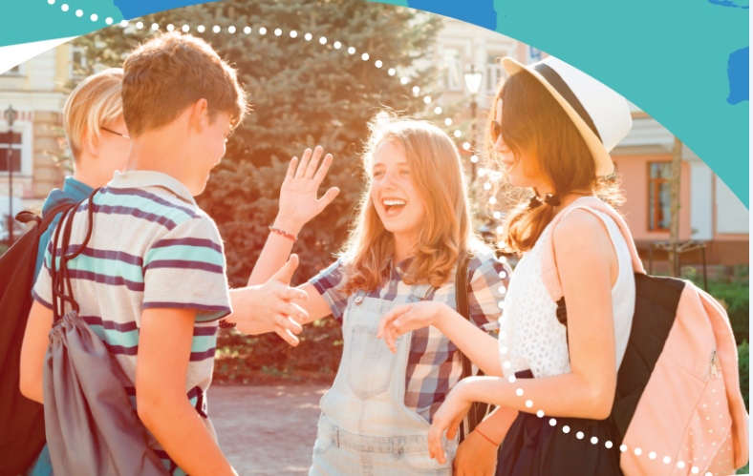


UNIT 6:
Around the world
Holidays

Slide 2
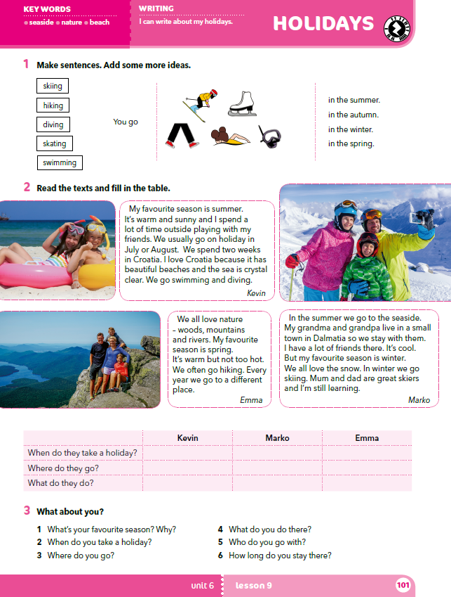
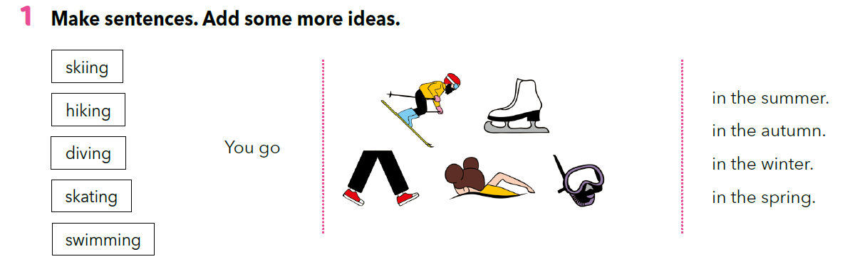

Slide 3
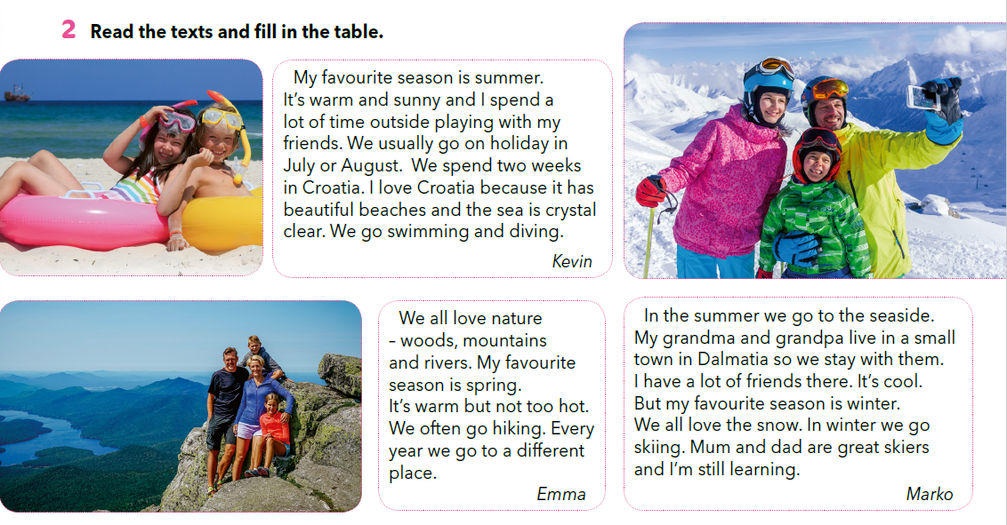
Describe the photos by answering the questions.
Who can you see?
Where are they?
What are they wearing?
What’s the weather like?
What season of the year is it?

Slide 4
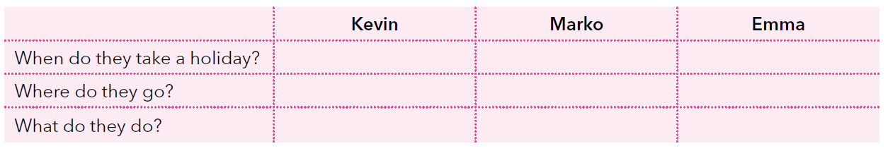
in July or August
in summer, in winter
in spring
Croatia
Dalmatia; mountains
Every year to a different place
goes swimming or diving
Spends time with his friends at the seaside; goes skiing with his parents
goes hiking

Slide 5
Read the text and your answers from the table once again.
Then close your book.
Try and answer the questions in full sentences.
Marko
Emma
Kevin
When does take a holiday?
Where does go?
What does do?
Emma
Marko
Kevin
Kevin
Emma
Marko

Slide 6
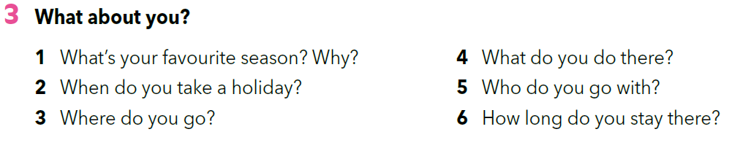



Slide 7
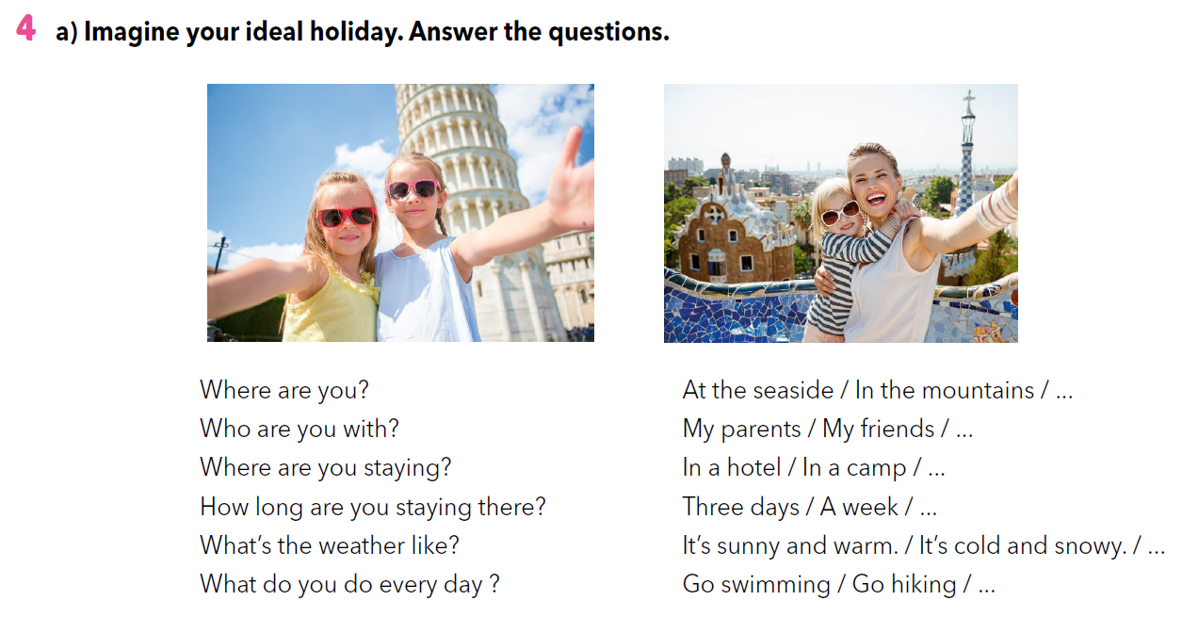

Slide 8
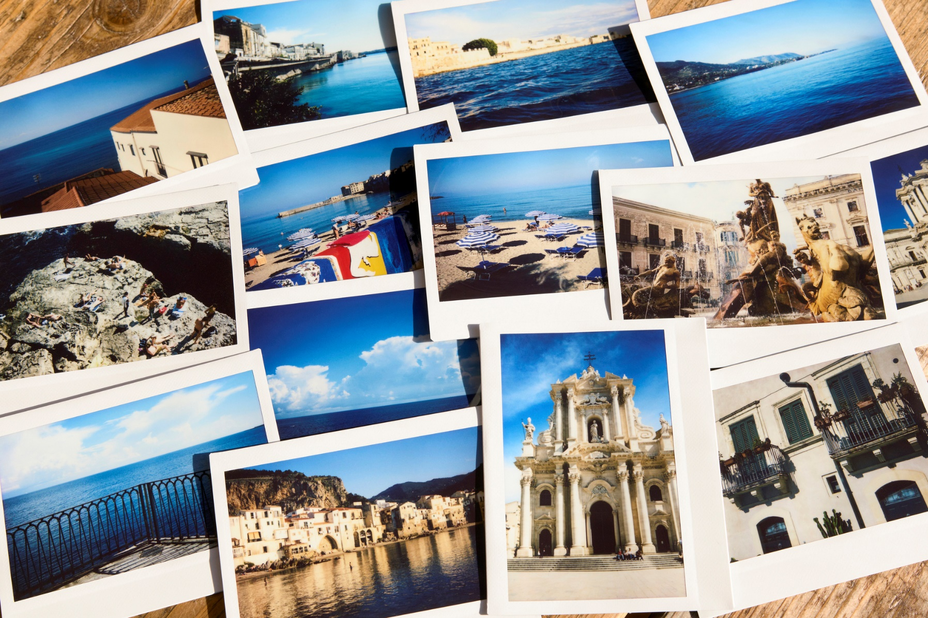

Slide 9
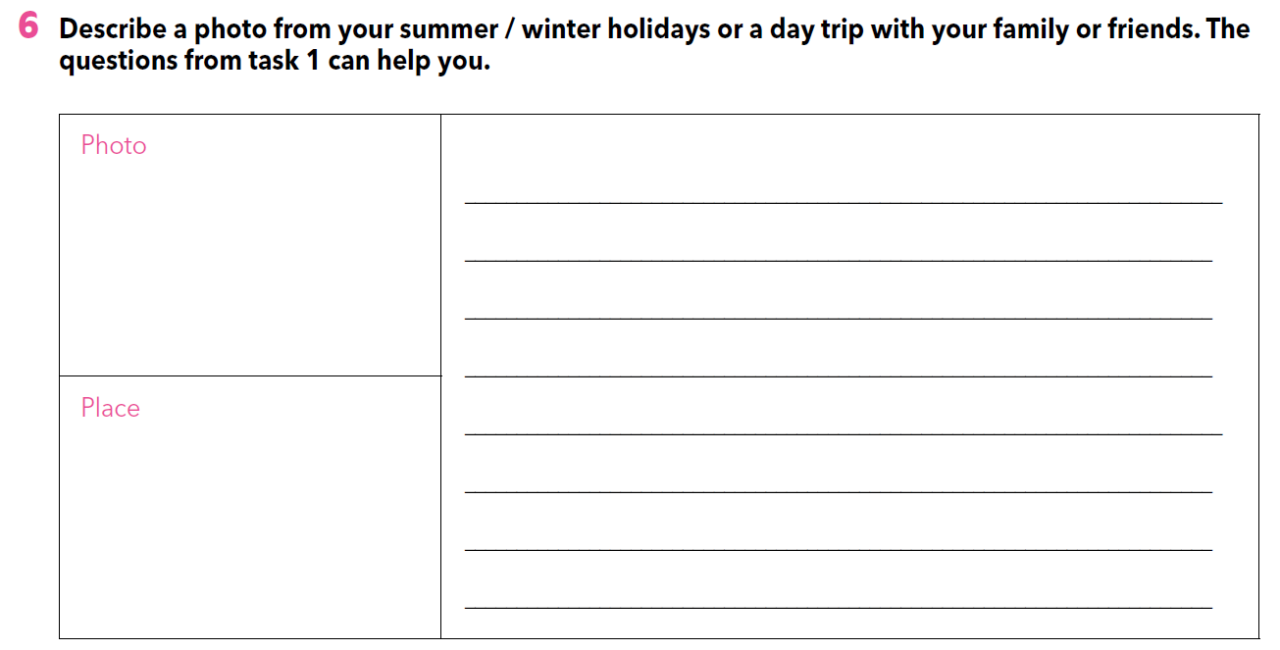

Slide 10
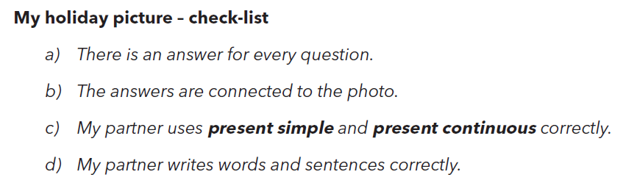

Slide 11
LET’S REVISE!
https://wordwall.net/play/260/277/816
https://wordwall.net/play/260/279/457
https://wordwall.net/play/260/280/201

